Slide 1



Introducing Early Educator Central:
Pathways to Credentials and Degrees for Infant-Toddler Educators
Notes:
Early Educator Central: Pathways to Credentials and Degrees for Infant-Toddler Educators is an on-line initiative that focuses on the careers of infant-toddler educators, seeking to advance their education and improve their competencies. Early Educator Central leverages previous federal investment in high quality coursework in support of infant-toddler educators, providing access to these courses. Besides leveraging these courses, and making them readily available, Early Educator Central is responsive to other professionals in the system, with other exciting and helpful tools to meet the needs of early childhood administrators, trainers and coaches, higher education professionals, and professional development systems leaders.

Slide 2

Introducing Early Educator Central:
Pathways to Credentials and Degrees for Infant-Toddler Educators
Notes:
Early Educator Central: Pathways to Credentials and Degrees for Infant-Toddler Educators is an on-line initiative that focuses on the careers of infant-toddler educators, seeking to advance their education and improve their competencies. Early Educator Central leverages previous federal investment in high quality coursework in support of infant-toddler educators, providing access to these courses. Besides leveraging these courses, and making them readily available, Early Educator Central is responsive to other professionals in the system, with other exciting and helpful tools to meet the needs of early childhood administrators, trainers and coaches, higher education professionals, and professional development systems leaders.

Slide 3
National Context
A valuable new asset in support of critical priorities:
  Training and career pathways under the Child Care and Development Fund (CCDF);
  Essential state and territory professional development planning and implementation to respond to CCDF reauthorization; and
  Professional development in Early Head Start-Child Care Partnerships and other programs.
Notes:
The national landscape provides part of the impetus for Early Educator Central.
The federal child care law provides for a focus on professionals working with children, calling for some new areas for training as well as support for career pathways.
A significant initiative from HHS is the Early Head Start- Child Care Partnerships which were initiated in 2015. These partnerships bring together child care and Early Head Start. There is a focus on the infant-toddler workforce and educators in this program must, at a minimum, have a CDA.

Slide 4
Early Educator Central
Leverages existing federally funded coursework from Administration for Children and Families, Department of Defense, and the Centers for Disease Control and Prevention.
Provides courses that are part of a career pathway that lead towards a credential or degree.
Jointly administered and funded by the Office of Child Care and the Office of Head Start.
Notes:
Early Educator Central has very well respected credible sponsors and partners. Federal agencies are involved who used federal dollars to develop coursework/curriculum that can become part of the pathway in attaining a credential or degree.
Both the federal Child Care and Head Start offices are sponsors.
From the beginning there was great contribution to the site from many stakeholders in its development.
The project was incubated by 3 well regarded early childhood organizations: ICF International , ZERO TO THREE and NAEYC
An expert panel also participated and provided advice and feedback

Slide 5
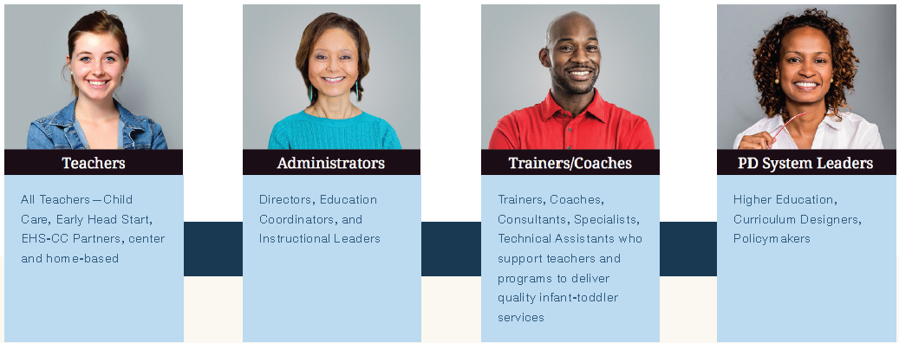
Audiences
Resources and tools that meet the needs of early childhood professionals, including:
Notes:
Early Educator Central focuses on four key audiences-
Early childhood teachers who work directly with young children, including both centers and family child care homes
Administrators who direct early childhood programs
Trainers, coaches and others who support teachers and programs in implementing quality practices
PD system leaders who include higher education faculty and curriculum designer as well as professional development system leaders and policymakers at the state level and within local agencies.

Slide 6
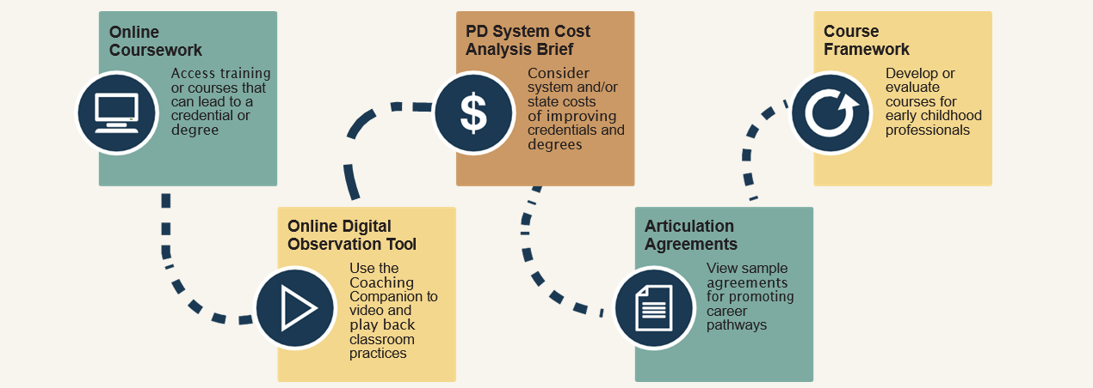
Early Educator Central Overview
Tools and resources organized by Career Pathway and Coursework, Teaching Supports and System Supports:
Notes:
Early Educator Central has an intuitive design. These are the big 3 categories for organization that you’ll see when you visit the web site: Career Pathways and Coursework; Teaching Supports; and System Supports.
In the next slides we’ll explore the resources that are organized into these areas of career pathway/coursework; teaching supports; and system supports. This slide gives you highlights of resources you will find in Early Educator Central.

Slide 7
Coursework

Slide 8

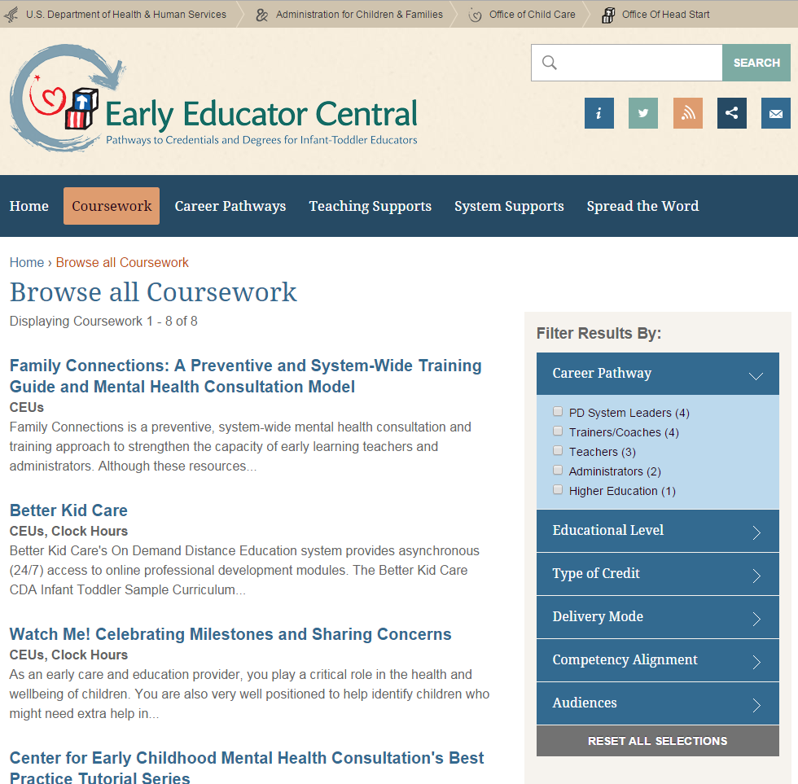
Coursework: Details
Allows for browsing of course descriptions, and filtering courses by role and other key indicators- all free or low cost.
Provides pathway courses for the CDA requirement of EHS &
EHS—CC partnerships.
Notes:
Early Educator Central is a gateway to free and low-cost courses that were all directly sponsored by the federal government, specifically Administration for Children and Families/Office of Head Start; Centers for Disease Control and Prevention; and Department of Defense.
Importantly, these courses can be searched by roles and other key indicators.
And, as we said at the beginning, these are pathway courses for the CDA requirements as well as other courses to help many types of professionals such as early childhood administrators or directors, trainers, coaches, higher education and Professional Development system leaders.

Slide 9
Coursework: Details
Coursework | Course Developer | Intended Audience
Department of Defense Virtual Lab School Infant Toddler Track | The Ohio State University | Infant Toddler Educators Administrators
Better Kid Care | Penn State Extension Better Kid Care Program | All Early Learning Educators Administrators
Online Infant Toddler Associate of Arts (A.A.) curriculum | University of Cincinnati | Infant Toddler Educators Course Developers and Higher Education Professionals PD System Planners
Infant Toddler Consultant Curricula Relationships: The Heart of Development and Learning Infant Toddler Development, Screening, and Assessment Infant Toddler Curriculum and Individualization | ZERO TO THREE | Coaches and Trainers PD System Planners
Notes:
In this slide and the next one, we review the coursework that is available through Early Educator Central. When you visit the website, you’ll find brief descriptions of each course that can be reviewed before following the link to get to the full course itself. You can search for courses by role and other key indicators. All of these courses were developed directly with federal funds by ACF, the Department of Defense, or the Centers for Disease Control and Prevention. All of these courses are free or low cost. And, as the last column shows, one option for finding coursework is to search by audience.

Slide 10
Coursework: Details
Coursework | Course Developer | Intended Audience
Family Connections: A Preventive and System-Wide Training Guide and Mental Health Consultation Model | Boston Children’s Hospital | Administrators Coaches and Trainers PD System Planners
Center for Early Childhood Mental Health Consultation’s Best Practice Tutorial Series | Georgetown University | Administrators Coaches and Trainers PD System Planners
Center on the Social and Emotional Foundations for Early Learning (CSEFEL) Infant Toddler Training Modules | Vanderbilt University | Infant Toddler Educators
Watch Me! Celebrating Milestones and Sharing Concerns | Centers for Disease Control and Prevention | Teachers

Slide 11
Teaching Supports

Slide 12

Teaching Supports: Course Framework
Use the “Know-See-Do-Improve” competency self-assessment course framework if you’re developing a course to support infant-toddler teachers and others.
The course framework could be used for credit-based as well as non-credit offerings by higher education, trainers, coaches, etc.
Use the online application process to upload a course you want us to consider for inclusion on the site.
Notes:
Teaching Supports constitutes the second big portion of Early Educator Central. Teaching Supports are aimed at professionals who support the teachers, such as administrators, coaches, PD systems leaders, etc. This part of Early Educator Central features a coursework frame using the Know See Do Improve framework, which is to impact and enhance teacher and provider practice. All courses on the website have been analyzed using this framework. In addition, the framework is available as a fillable PDF file so that those developing courses can use it. A state PD system might want to apply it to any courses that they are authorizing whether for credit or not and a local PD leader might want to use this framework to ensure quality practices are being implemented. You can also use the online application process to upload a course you want us to consider for inclusion on the site. The online application takes you through a questionnaire that includes our required criteria.

Slide 13
Teaching Supports:
The Coaching Companion
Find an open-source, digital teacher observation tool, The Head Start Coaching Companion.
The Head Start Coaching Companion provides an opportunity to improve practice through video, which can be shared with administrators, coaches, or higher education faculty.
Notes:
Observing practice in the classroom or family child care setting can be difficult to do. Through the link to the Coaching Companion, which is a free online digital observation tool, teachers can upload videos to share with supervisors, coaches. In a higher education context, the Coaching Companion can be used by faculty to observe how educators are doing in implementing their knowledge in the classroom. Another option is for a cadre of supervisors or coaches to use this together with teachers and providers.

Slide 14
Teaching Supports:
The Head Start Coaching Companion
Provides a safe place for home visitors and teachers to ask questions and share concerns.
Enables teams to share videos, photos, and documents in a private, password-protected space.
Includes Action Planning for teams to set measurable goals and define specific steps to achieve them.
Features Focused Observation, including goals, notes, and video-based observations.
Allows teams to annotate videos for Reflection and Feedback.
Notes:
The Coaching Companion was developed by the University of Washington through their work as a national center for the federal government. The Coaching Companion is linked to Early Educator Central and it provides some great resources!

Slide 15

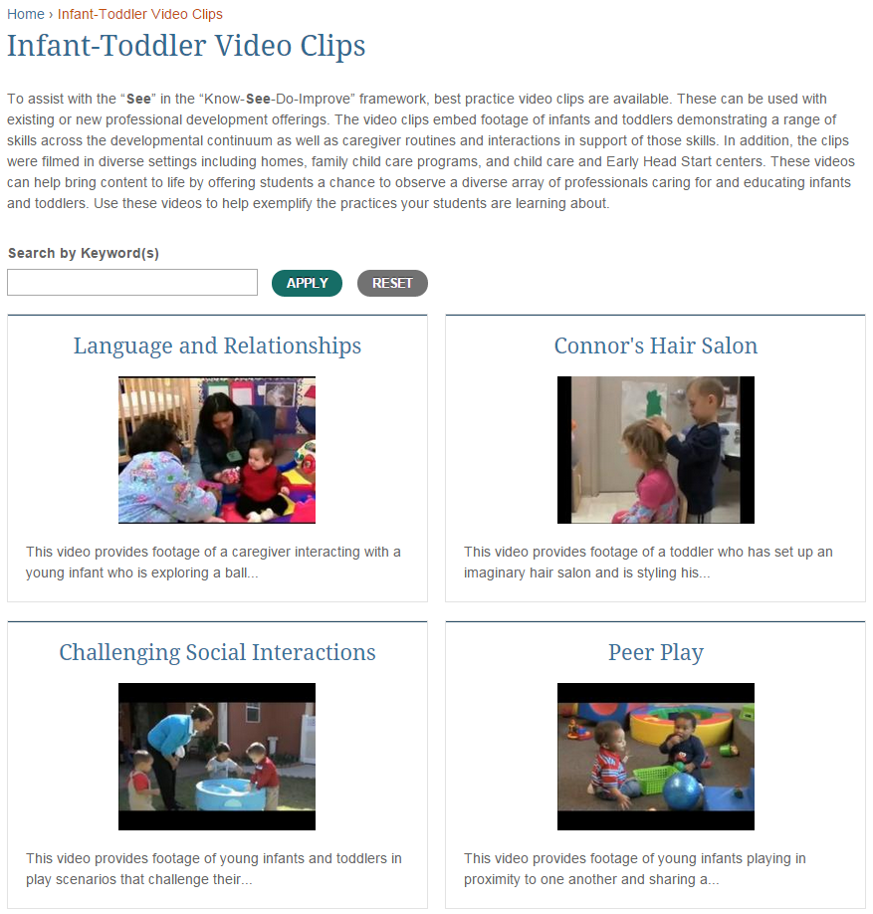
Teaching Supports:
Infant Toddler Video Clips
View video clips of infants, toddlers and their educators to observe good practice.
Could be used by educators as part of training and coursework.
Notes:
Another practical support you’ll see on the Teaching Supports part of Early Educator Central is infant-toddler video clips, which can allow educators to observe and discuss good practice. These can be used as part of training and coursework.

Slide 16

Teaching Support: Additional Resources
Review annotated bibliographies for designers of higher education courses for infant-toddler educators in areas such as:
  Dual language learners
  Mathematics
  Science
  Poverty, Race and Culture
  Technology
Learn more about strategies to successfully include infant-toddler courses and family child care providers in higher education.
Notes:
And there’s more in teaching supports. If you’re a course developer, you might want to check out the annotated bibliographies that could be used to inform your design of classes for infant toddler educators.
At the same time, you can also find good information about how to successfully include infant-toddler courses in higher education as well as family child care providers in higher education! The guide to including family child care providers is written by a team of higher education faculty working with family child care providers.

Slide 17
System Supports

Slide 18



System Supports:
PD System Cost Analysis Brief
  Informs planning and development of statewide and/or agency wide professional development with a focus on credit-bearing credentials and degrees.
  Helps planners understand costs associated with helping early childhood professionals gain degrees and credentials.
Notes:
Early Educator Central has several system supports. We will start with the professional development system cost brief. That is a mouthful- but this is a tool that can be used to help inform planning and development of both statewide PD systems for helping people acquire credentials and degrees It can also be used by programs. It has many diverse users- could be used to plan a pre-k initiative or to plan for infant-toddler initiatives, for example, and it supports PD systems beyond those serving infants and toddlers.

Slide 19
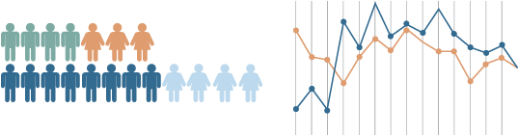
System Supports:
PD System Cost Analysis Brief
The tool helps planners answer questions like:
  What qualifications does your workforce currently have?
  What qualifications do you need or want it to have?
  What do you need to target to help meet your goals of building and retaining a qualified workforce?
Notes:
Here’s some more background on the types of questions you might answer with the PD tool

Slide 20
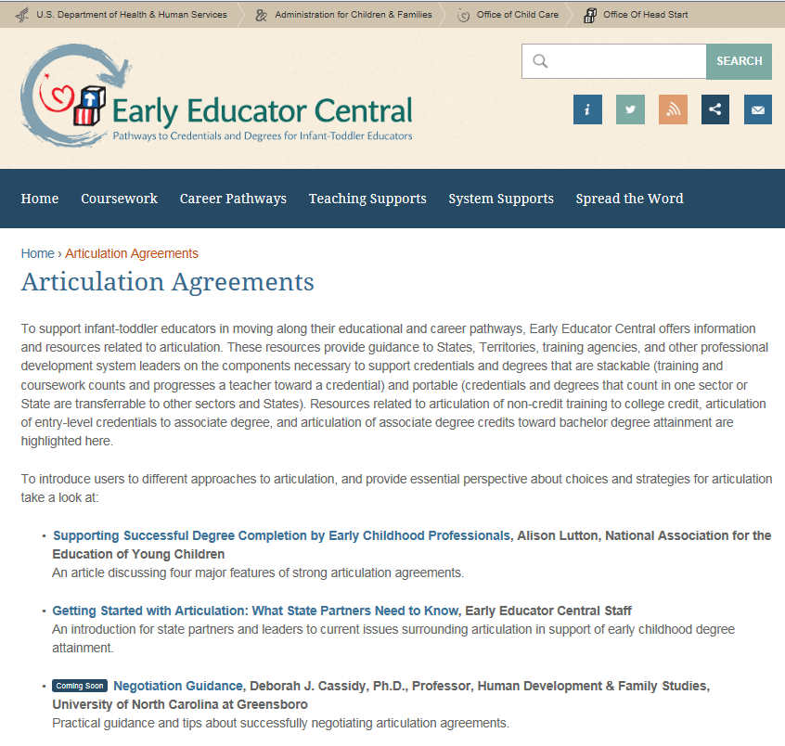
System Supports: Articulation Agreements
Background on Articulation.
Templates to inform work to create Articulation Agreements.
Sample agreements from around the country.
Notes:
Transfer and articulation of credit towards AA and BA degrees is a large issue in early childhood. Early Educator Central has a lot of resources including templates that can be used to create articulation agreements, actual agreements from around the country, and guidance and advice for those working on this topic.

Slide 21
System Supports: Resources
Find additional resources including:
A review of options and opportunities for financing high quality infant-toddler programming.
Learn more about infant-toddler teacher compensation.
Notes:
And finally, there are some additional resources on system supports.

Slide 22
Spread the Word!
To help you spread the word, Early Educator Central has materials. You’ll find:
Early Educator Central banners to place on your website. These banners will bring your visitors directly to Early Educator Central’s homepage.
Social Media Messages for use on Facebook, Twitter and other social media.
Factsheet
Talking Points
FAQ’s
PowerPoint
Notes:
Banners- digital banners that can be posted on websites and link directly to Early Educator Central
Social Media Messages- messages to spread the word about different aspects of Early Educator Central that appeal to different audiences
Factsheet- a lively infographic to describe Early Educator Central
Talking Points- basic information on Early Educator Central
FAQs- Frequently asked questions that may be of value
PowerPoint- we’ve excerpted from the PowerPoint for today’s discussion

